Slide 1
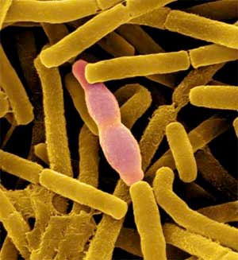
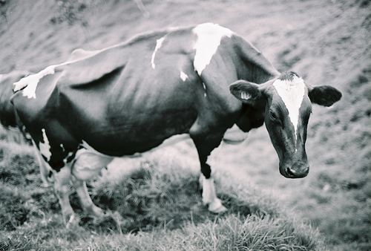
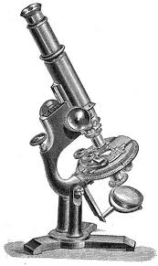
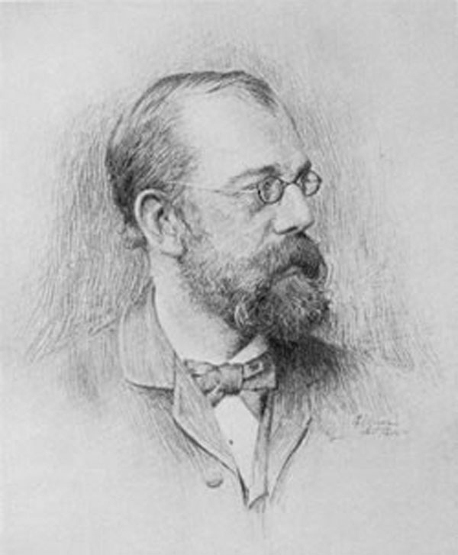
Infectious Diseases
Lesson 2.3

Slide 2
Lesson Objectives:
After finishing today’s lesson you will be able to:
explain the process by which a disease spreads.
explain the effects of vaccination on the spread of a disease.

Slide 3
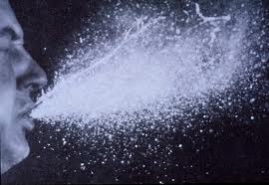
Do Now
What would you expect to observe if a disease is contagious?

Slide 4
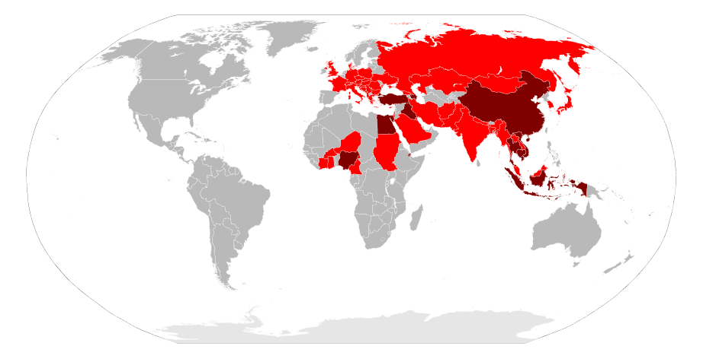
Activity: Simulating the spread of an infectious disease
Notes:
Spread map of H1N5, 2009

Slide 5
Discussion
If we vaccinated half the class and ran the simulation again how many people would get infected?

Slide 6
Let’s look at some data!
No vaccination
DAY | 1 | 2 | 3 | 4 | 5 | 6
Total cases | 100 | 200 | 400 | 800 | 1,600 | 3,200
New cases | 0 | 100 | 200 | 400 | 800 | 1600
If 50% of people were vaccinated…
DAY | 1 | 2 | 3 | 4 | 5 | 6
Total cases | 100 | 150 | 225 | 337.5 | 506.25 | 759.375
New cases | 0 | 50 | 75 | 112.5 | 168.75 | 253.125

Slide 7
Here is a graph of the spread over 15 days

Slide 8
Wrap Up
How would you prove a disease is caused by an infectious agent?

Slide 9
Wrap Up
How would you prove a disease is caused by an infectious agent?
Koch’s postulates
Association – It must always be present in every case – but not in healthy animals.
Isolation – It must be isolated from the sick animal into pure culture.*
Causation – The pure microbe must cause the disease in a healthy animal.
Re-isolation – When the microbe is re-isolated from the sick animal it must be the same as the original.
*Pure culture of a microbe means that there is only one type of microbe growing.
Robert Koch

Slide 10
Homework
Review Koch’s postulates and explain whether typhoid fever (lesson 2.1) fulfills each postulate.

